Slide 1
Chapter 14
Switching
Circuit Switching
Packet Switching
Message Switching
WCB/McGraw-Hill
© The McGraw-Hill Companies, Inc., 1998

Slide 2
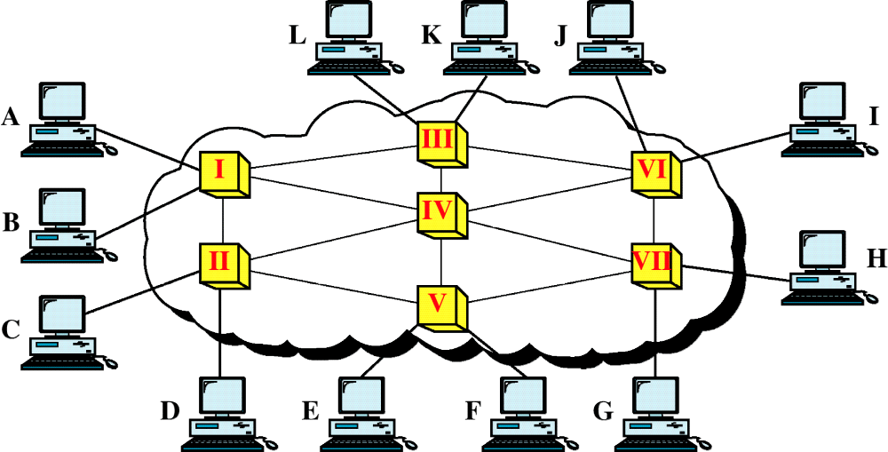
Figure 14-1
Switched Network
WCB/McGraw-Hill
© The McGraw-Hill Companies, Inc., 1998

Slide 3
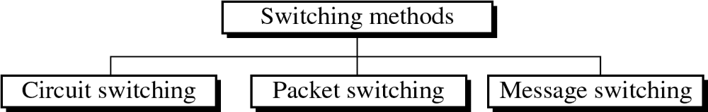
Figure 14-2
WCB/McGraw-Hill
© The McGraw-Hill Companies, Inc., 1998

Slide 4
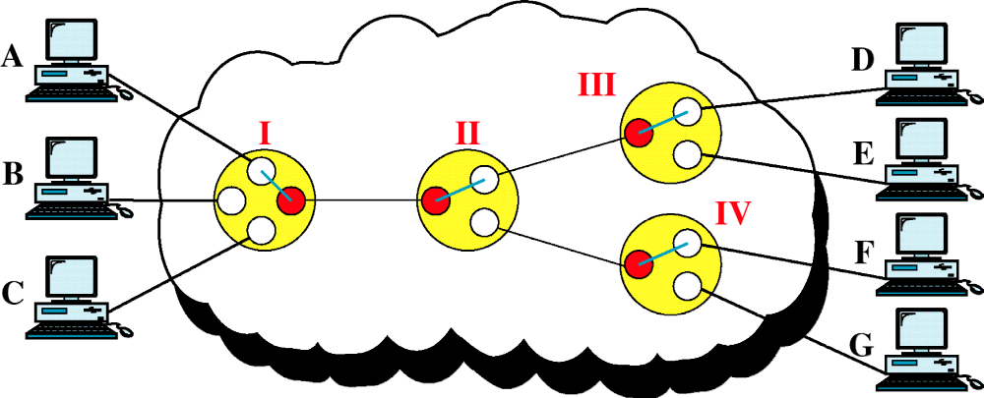
Figure 14-3
Circuit-Switched Network
WCB/McGraw-Hill
© The McGraw-Hill Companies, Inc., 1998

Slide 5
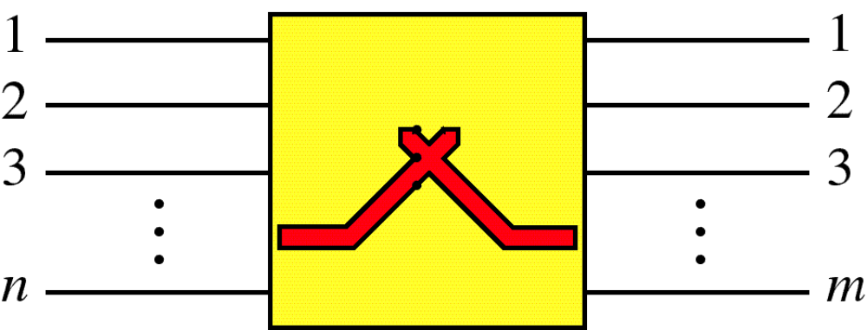
Figure 14-4
Switch
WCB/McGraw-Hill
© The McGraw-Hill Companies, Inc., 1998

Slide 6
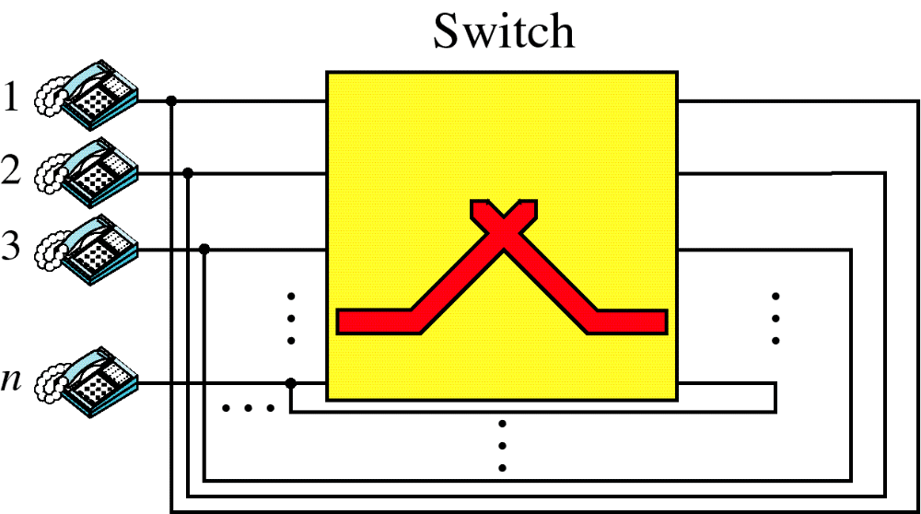
Figure 14-5
Folded Switch
WCB/McGraw-Hill
© The McGraw-Hill Companies, Inc., 1998

Slide 7
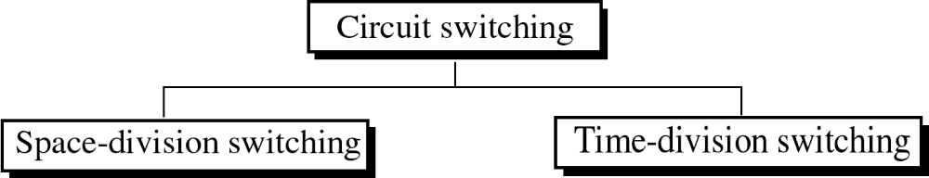
Figure 14-6
WCB/McGraw-Hill
© The McGraw-Hill Companies, Inc., 1998

Slide 8
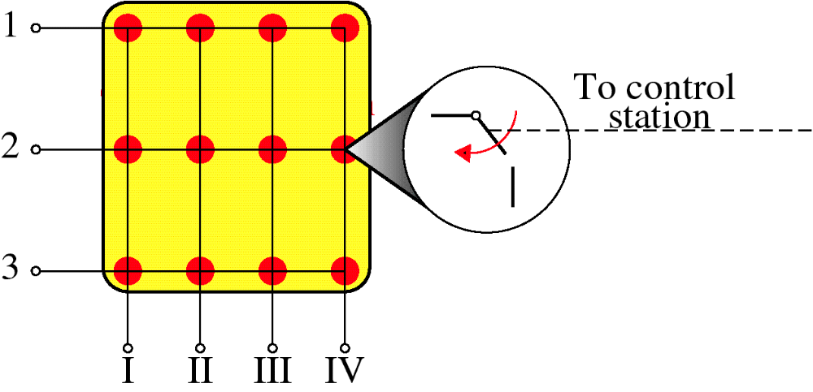
Figure 14-7
Crossbar Switch
WCB/McGraw-Hill
© The McGraw-Hill Companies, Inc., 1998

Slide 9
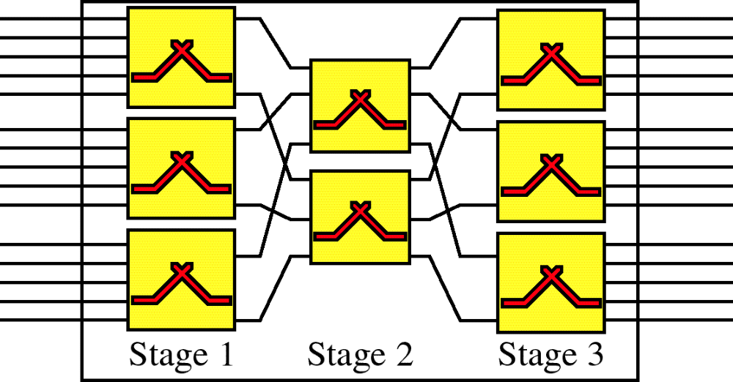
Figure 14-8
Multistage Switch
WCB/McGraw-Hill
© The McGraw-Hill Companies, Inc., 1998

Slide 10
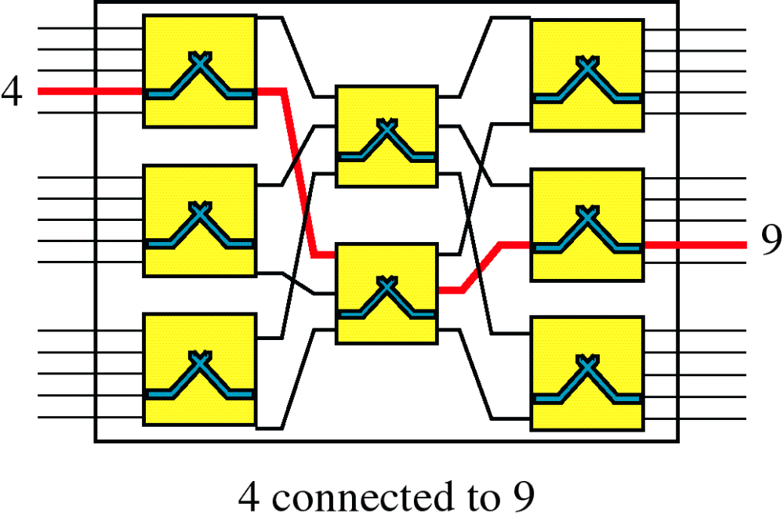
Figure 14-9
Switching Path
WCB/McGraw-Hill
© The McGraw-Hill Companies, Inc., 1998

Slide 11
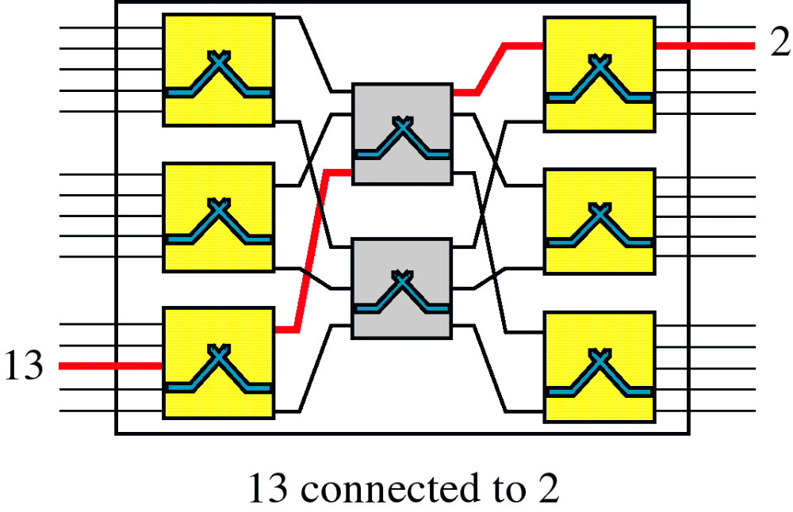
Figure 14-9-continued
Switching Path
WCB/McGraw-Hill
© The McGraw-Hill Companies, Inc., 1998

Slide 12
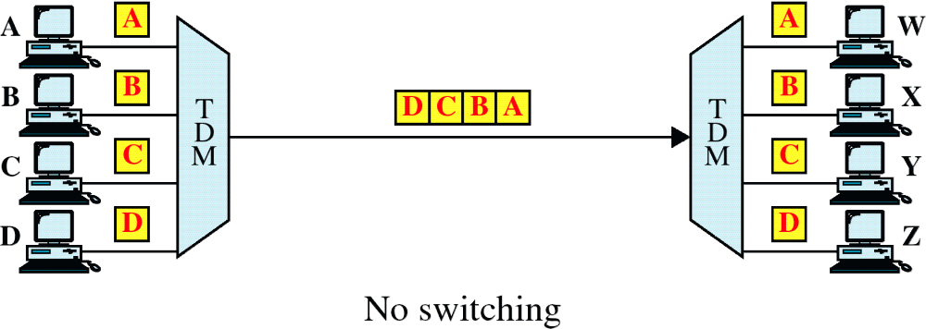
Figure 14-10
TDM without TSI
WCB/McGraw-Hill
© The McGraw-Hill Companies, Inc., 1998

Slide 13
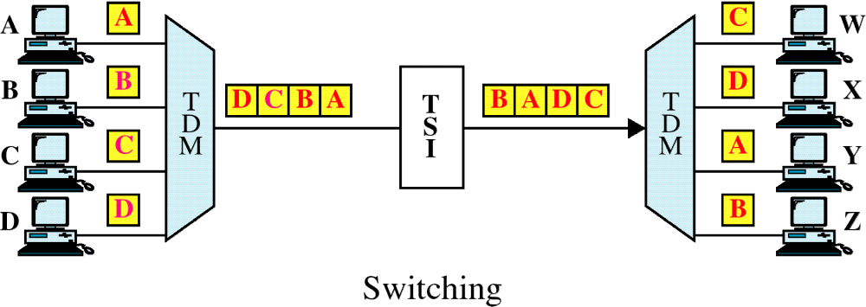
Figure 14-10-continued
TDM with TSI
WCB/McGraw-Hill
© The McGraw-Hill Companies, Inc., 1998

Slide 14
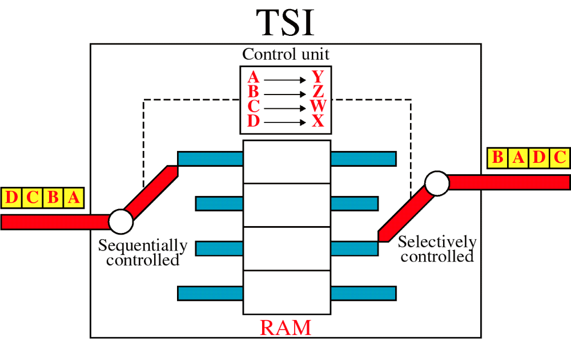
Figure 14-11
Time-Slot Interchange
WCB/McGraw-Hill
© The McGraw-Hill Companies, Inc., 1998

Slide 15
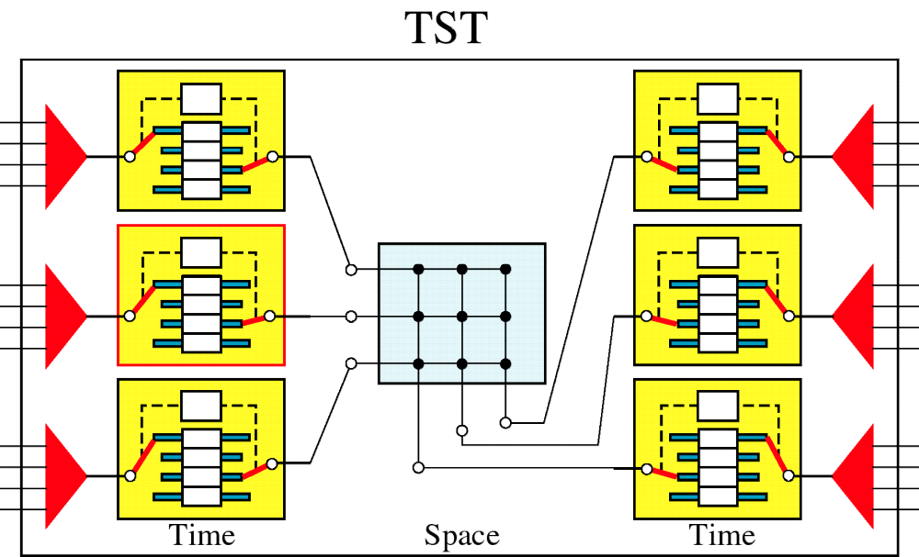
Figure 14-12
TST Switch
WCB/McGraw-Hill
© The McGraw-Hill Companies, Inc., 1998

Slide 16
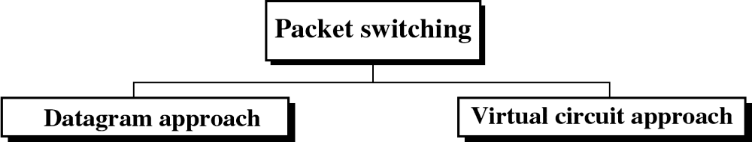
Figure 14-13
WCB/McGraw-Hill
© The McGraw-Hill Companies, Inc., 1998

Slide 17
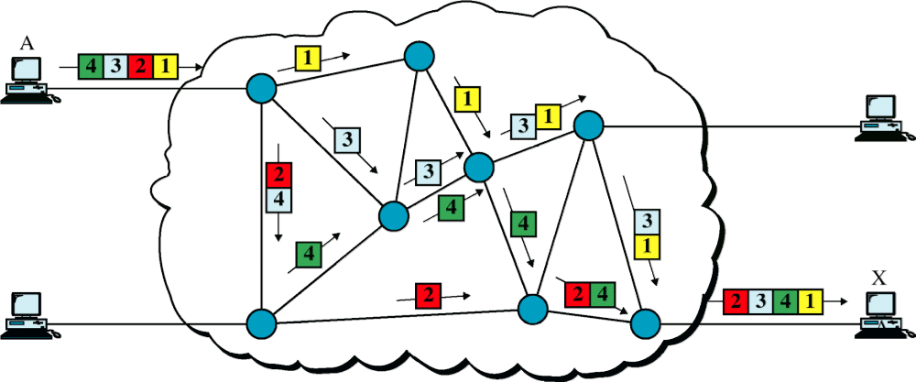
Figure 14-14
Datagram Approach
WCB/McGraw-Hill
© The McGraw-Hill Companies, Inc., 1998

Slide 18
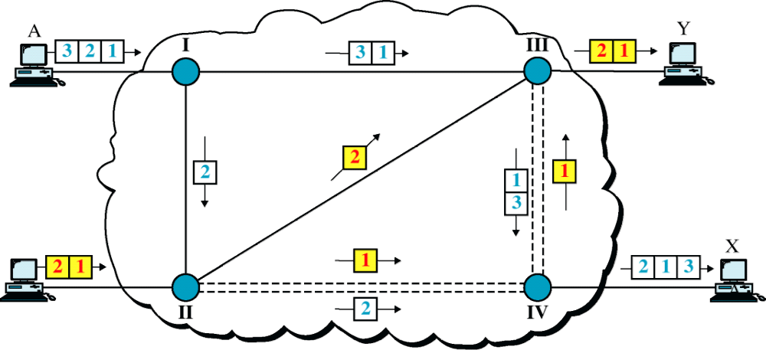
Figure 14-15
Datagram Approach, Multiple Channels
WCB/McGraw-Hill
© The McGraw-Hill Companies, Inc., 1998

Slide 19
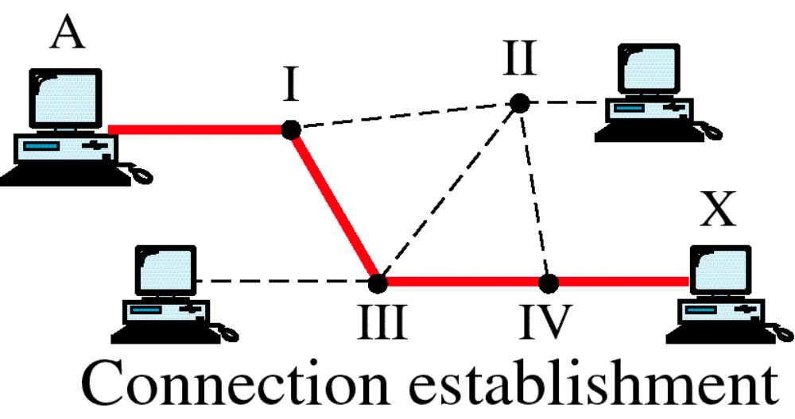
Figure 14-16
Switched Virtual Circuit
WCB/McGraw-Hill
© The McGraw-Hill Companies, Inc., 1998

Slide 20
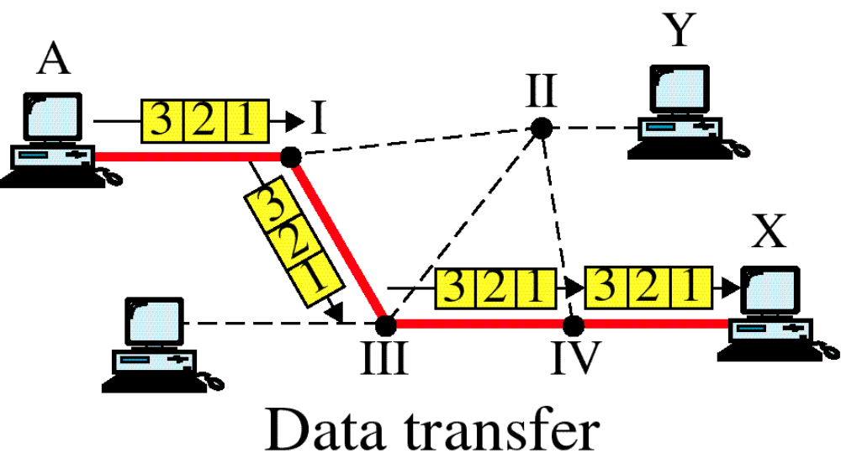
Figure 14-16-continued
Switched Virtual Circuit
WCB/McGraw-Hill
© The McGraw-Hill Companies, Inc., 1998

Slide 21
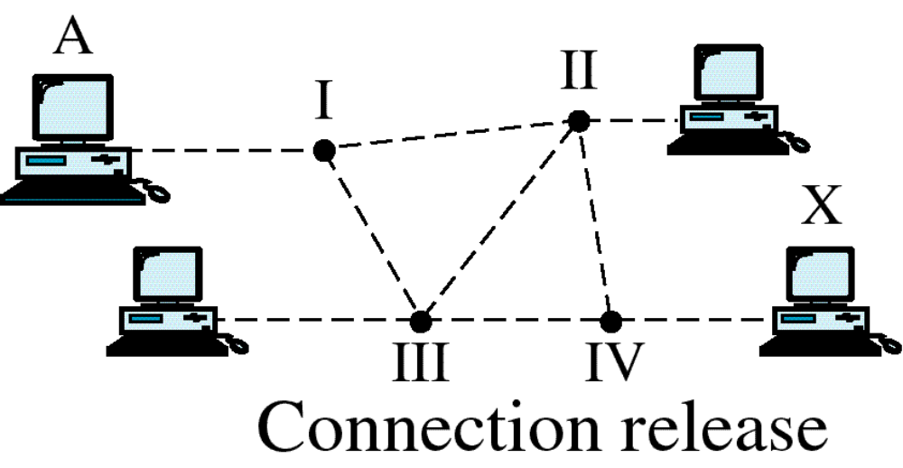
Figure 14-16-continued
Switched Virtual Circuit
WCB/McGraw-Hill
© The McGraw-Hill Companies, Inc., 1998

Slide 22
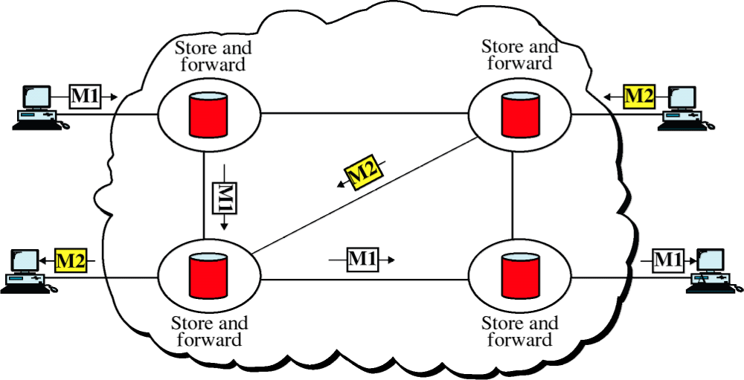
Figure 14-17
Message Switching
WCB/McGraw-Hill
© The McGraw-Hill Companies, Inc., 1998

